Slide 1
Data Readiness
Power BI dashboard
8th, February 2021
Danielle Paes Barretto

Slide 2
Pre-requisites
Download and Install PowerBI Desktop
Download files from GitHub
Take a look at the data to have an idea what is about

Slide 3
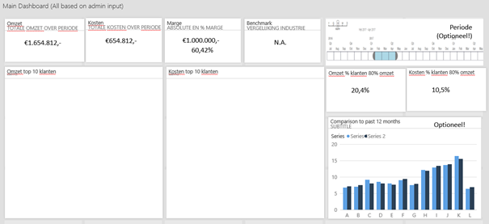
Goal
Cost
Margin
Benchmark
Time Indicator
Revenue
80-20 division of clients
Top 10 clients (revenue)
comparison vs the month last year
Top 10 clients (cost)

Slide 4
Dataset
AdventureWorks DW Scripts Zip
We will use a subset:
FactInternSale
DimCustomer
DimDate
DimProduct
DimProductCategory
DimProductSubCategory
DimSalesTerritory

Slide 5
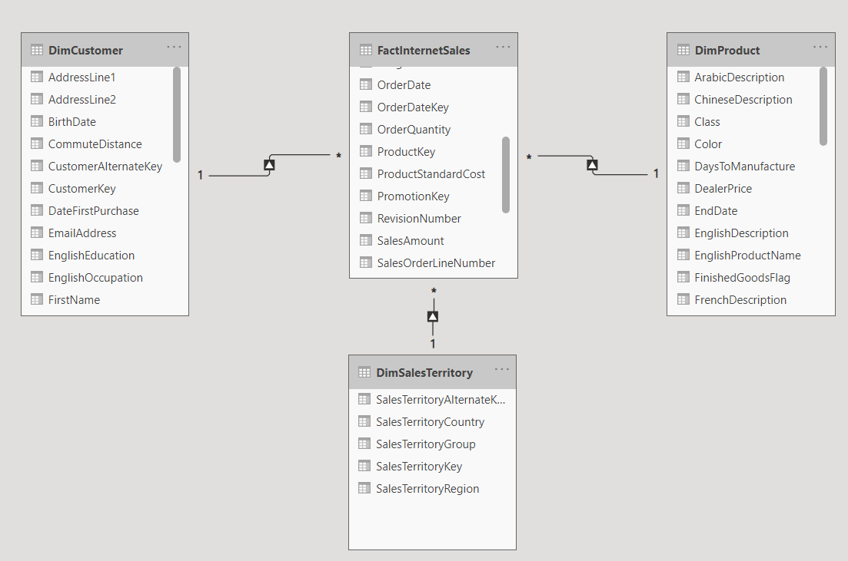
Snowflake Schema
Fact table: Events & Transactions
Dimension Tables: More info about each transaction in Fact Table

Slide 6
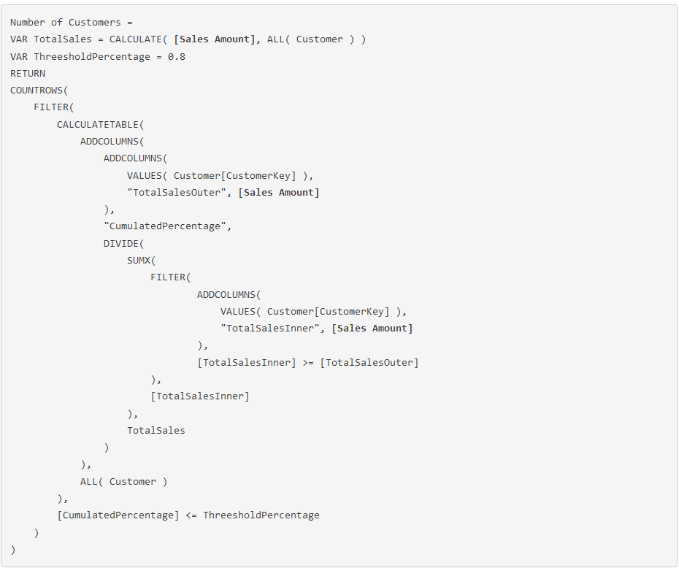
Count of Clients who are contribute for 80 % sales
https://community.powerbi.com/t5/Desktop/Count-of-Clients-who-are-contribute-for-80-sales-spends/m-p/618851#M295197

Slide 7
References
https://docs.microsoft.com/en-us/dax/dax-function-reference
https://docs.microsoft.com/en-us/learn/modules/get-started-with-power-bi/

